Slide 1

AI × Multimodal Processing
PulsePointAI
Transforming Long-Form Wisdom into Viral Moments
Extracting emotional peaks from hours of content, making high-level education snackable and shareable for modern audiences
GenAI
Multimodal
Real-Time
Emotional Intelligence
Video Analysis
Processing

Slide 2
Journey Map
The Content Paradox
01
04
The Problem
Technical Architecture
Buried wisdom in long-form content, 8-second attention spans, and the manual editing nightmare
Multimodal AI engine fusing audio, visual, and text analysis with real-time processing
02
05
The Opportunity
Impact & Future
$100B short-form market, 82% of internet traffic, 75% consumption growth
Making wisdom viral, roadmap to 10,000 users, and transforming educational content
03
Hackathon Goal
The Solution
MVP with multimodal peak detection
PulsePoint AI platform with multimodal intelligence, smart cropping, and dynamic captions

Slide 3
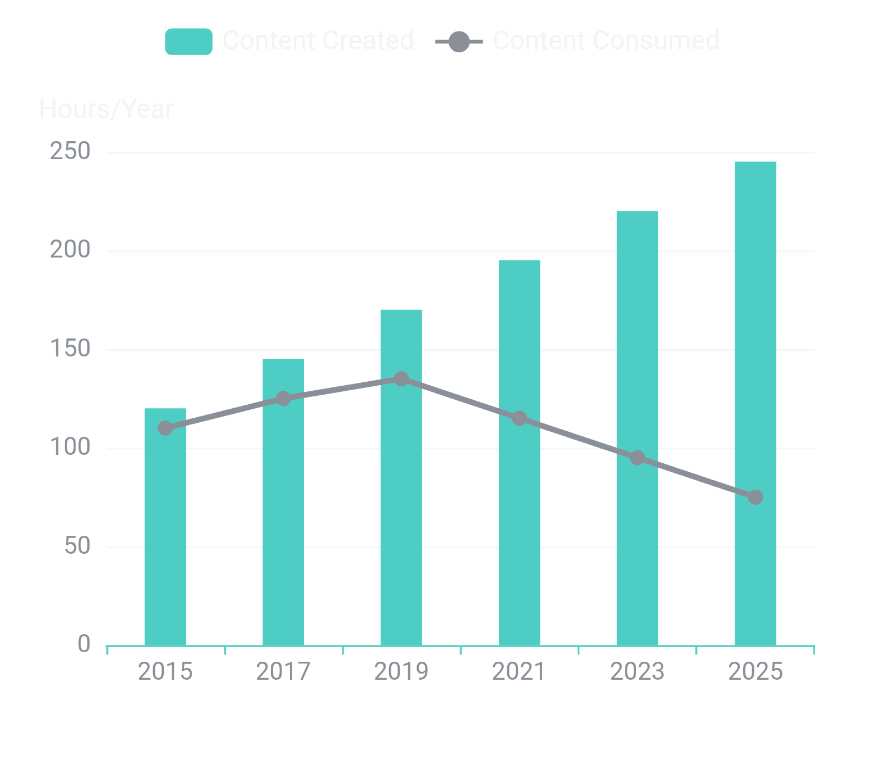
The Problem
The Attention Crisis
Content Consumption Gap
The Great Disconnect
Educators produce hours of high-value content. Students consume information in 60-second bursts. Valuable "golden nuggets" of wisdom are buried in 60-minute videos, making them inaccessible to the modern viewer.
78%
prefer short video for learning
8s
60m
Attention Span
Lecture Length
Below goldfish level
Average educational video
Result: 90%+ of educational content goes unwatched by modern audiences
Educators
2-4 hours content creation
Students
60-90 second consumption

Slide 4
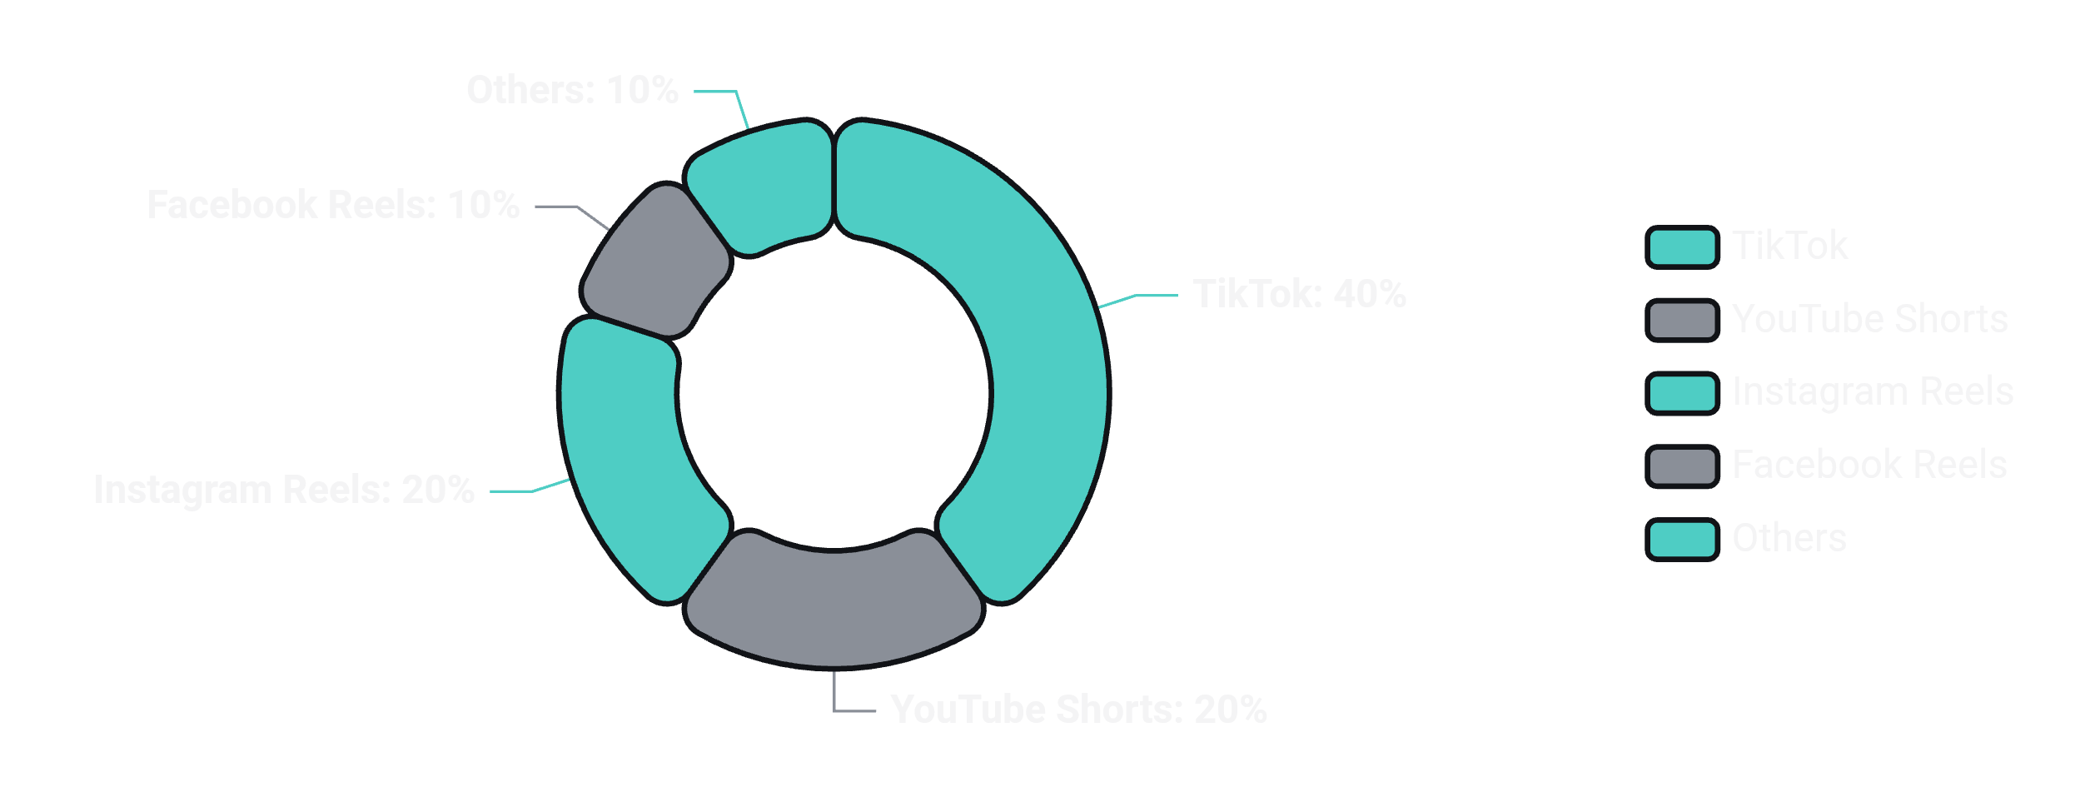
The Opportunity
The $100B Short-Form Gold Rush
82%
75%
35h
$140B
Internet Traffic
Consumption Growth
Monthly Usage
Ad Spend
Video by 2025
Short-form since 2020
TikTok per user
2025 projection
Platform Market Share
93%
Marketers Investing
Maintaining or increasing video spend in 2025
2.5x
Engagement Boost
Short-form vs. long-form on social platforms
70%
Gen Z Consumption
Watch 3+ hours daily

Slide 5
User Pain Points
Meet the Problem
Dr. Sarah Chen
The Manual Editing Nightmare
University Professor
1
Scrub Through Footage
Creates 2-hour weekly lectures on machine learning. Spends 6+ hours manually editing, but students only watch 5-10 minute clips on TikTok.
1-2 hours finding potential moments
Current workflow: Record → Review → Manually clip → Add captions → Export → Upload
Identify Highlights
2
30-45 minutes selecting clips
Marcus Rodriguez
3
Transcribe & Caption
Podcast Host
1-2 hours manual timing
Produces 90-minute weekly episodes. Knows there are viral moments buried inside, but can't find them without listening to entire recordings.
4
Crop to Vertical
Goal: Extract 5-10 clips per episode for social media promotion
30-60 minutes speaker tracking
5
Export & Upload
Jennifer Park
30-45 minutes processing
Workshop Facilitator
Runs 4-hour professional development sessions. Wants to share key insights online, but manual editing is prohibitively time-consuming.
4-6 Hours
Per 60-minute video
Challenge: Horizontal to vertical conversion loses speaker context

Slide 6
The Solution
Intelligent Moment Detection
PulsePoint AI uses multimodal AI to automatically detect emotional peaks and viral moments by analyzing audio energy, facial expressions, and text sentiment in real-time.
Audio Analysis
Visual Analysis
Text Analysis
Energy Spike Detection: Identifies volume & intensity changes
Facial Expressions: Detects smiles, surprise, intensity
Sentiment Analysis: Positive, negative, neutral emotion
Pitch Variation: Detects excitement, emphasis, emotional tone
Action Units: Micro-expressions using OpenFace
Keyword Triggers: "Profound", "breakthrough", "secret"
Eye Tracking: Gaze direction & engagement indicators
Pause Analysis: Dramatic silences & speech patterns
Emotional Intensity: Word choice & emphasis patterns
Body Language: Gestures & posture analysis
Speech Rate: Changes indicating passion or urgency
Question Detection: Rhetorical questions that hook viewers
Multimodal Fusion
65.7%
Combines audio, visual, and text signals into a single "viral score" for each moment
Accuracy
Emotion recognition

Slide 7
Complete Feature Set
Smart Production Suite
Hook Generation
Smart Crop
GenAI creates scroll-stopping headlines and descriptions optimized for each platform.
Computer vision tracks the speaker's face, preserving expressive zones during vertical conversion.
Face Tracking: Maintains speaker centered in frame
Expressive Zone Preservation: Keeps forehead, eyebrows, and jawline visible
Platform Optimization: TikTok vs. Reels vs. Shorts
Smooth Transitions: AI predicts movement to prevent jarring crops
Trending Keywords: Incorporates viral hashtags
Dynamic Captions
One Upload → Week of Content
60-min lecture
→
10-15 clips
AI-generated, karaoke-style subtitles with high-contrast overlays, timed perfectly to speech patterns.
90-min podcast
→
8-12 clips
Auto-Generated: 95%+ transcription accuracy
4-hour workshop
→
20-30 clips
Animated Overlays: Words highlight as they're spoken
High Contrast: Readable on any background
15 min
Total processing time

Slide 8
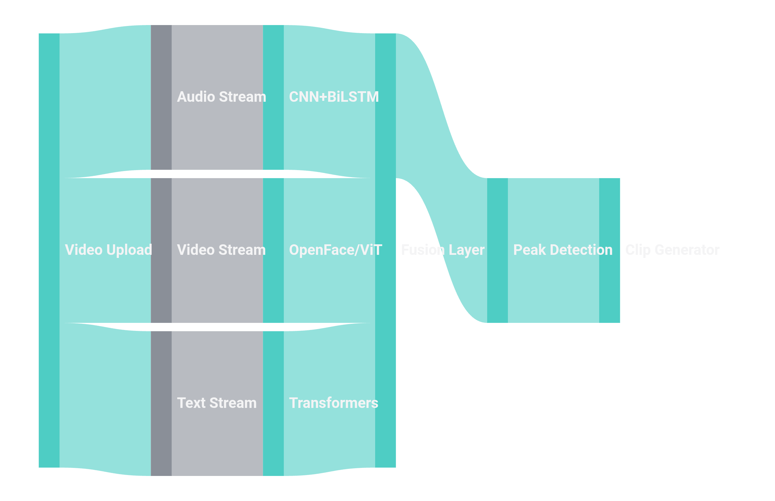
Under the Hood
The Multimodal Engine
System Architecture & Data Flow
Processing Pipeline
1.
Video Upload (supports 1GB+)
2.
Parallel stream processing
3.
Temporal alignment & fusion
4.
Viral score calculation
5.
Clip generation & export
Performance Metrics
Processing Speed
13ms/s
Real-time capability
Emotion Recognition
65.7%
4.5% improvement
Sentiment Analysis
82.5 F1
Out-of-domain data
Tech Stack
• Python/PyTorch
• OpenFace/ViT
• CNN+BiLSTM
• Transformers
• FFmpeg
• React/Tailwind

Slide 9
Technical Deep Dive
Decoding Emotional Peaks
Accuracy Benchmarks
Multimodal Fusion Algorithm
Emotion Recognition
65.7%
1. Feature Extraction
Concurrent analysis of audio (MFCC, pitch), visual (Action Units), and text (sentiment) features.
+4.5% vs. SVM baseline
Sentiment Analysis
82.5%
2. Peak Frame Selection
F1-score on out-of-domain data
Using argmax of cumulative AU intensity to find peak emotional moments.
Real-Time Processing
13ms/s
3. Temporal Alignment
Per second of speech
Syncing audio-visual-text data with millisecond precision for coherent context.
4. Weighted Fusion
Combining confidence scores from each modality: F = αA + βV + γT
Datasets & Training
Viral Score Calculation
RAVDESS: Ryerson Audio-Visual Database
// Emotional intensity score
EmoDB: Berlin Emotional Speech
E = Σ(AUᵢ × wᵢ)
TESS: Toronto Emotional Speech Set
// Audio energy factor
MERR: Multimodal Emotion Recognition
A = RMS(audio) × pitch_var
// Text sentiment weight
Data Augmentation: Noise addition, spectrogram shifting for robustness
T = sentiment_score × keywords
// Final viral score
V = αE + βA + γT

Slide 10
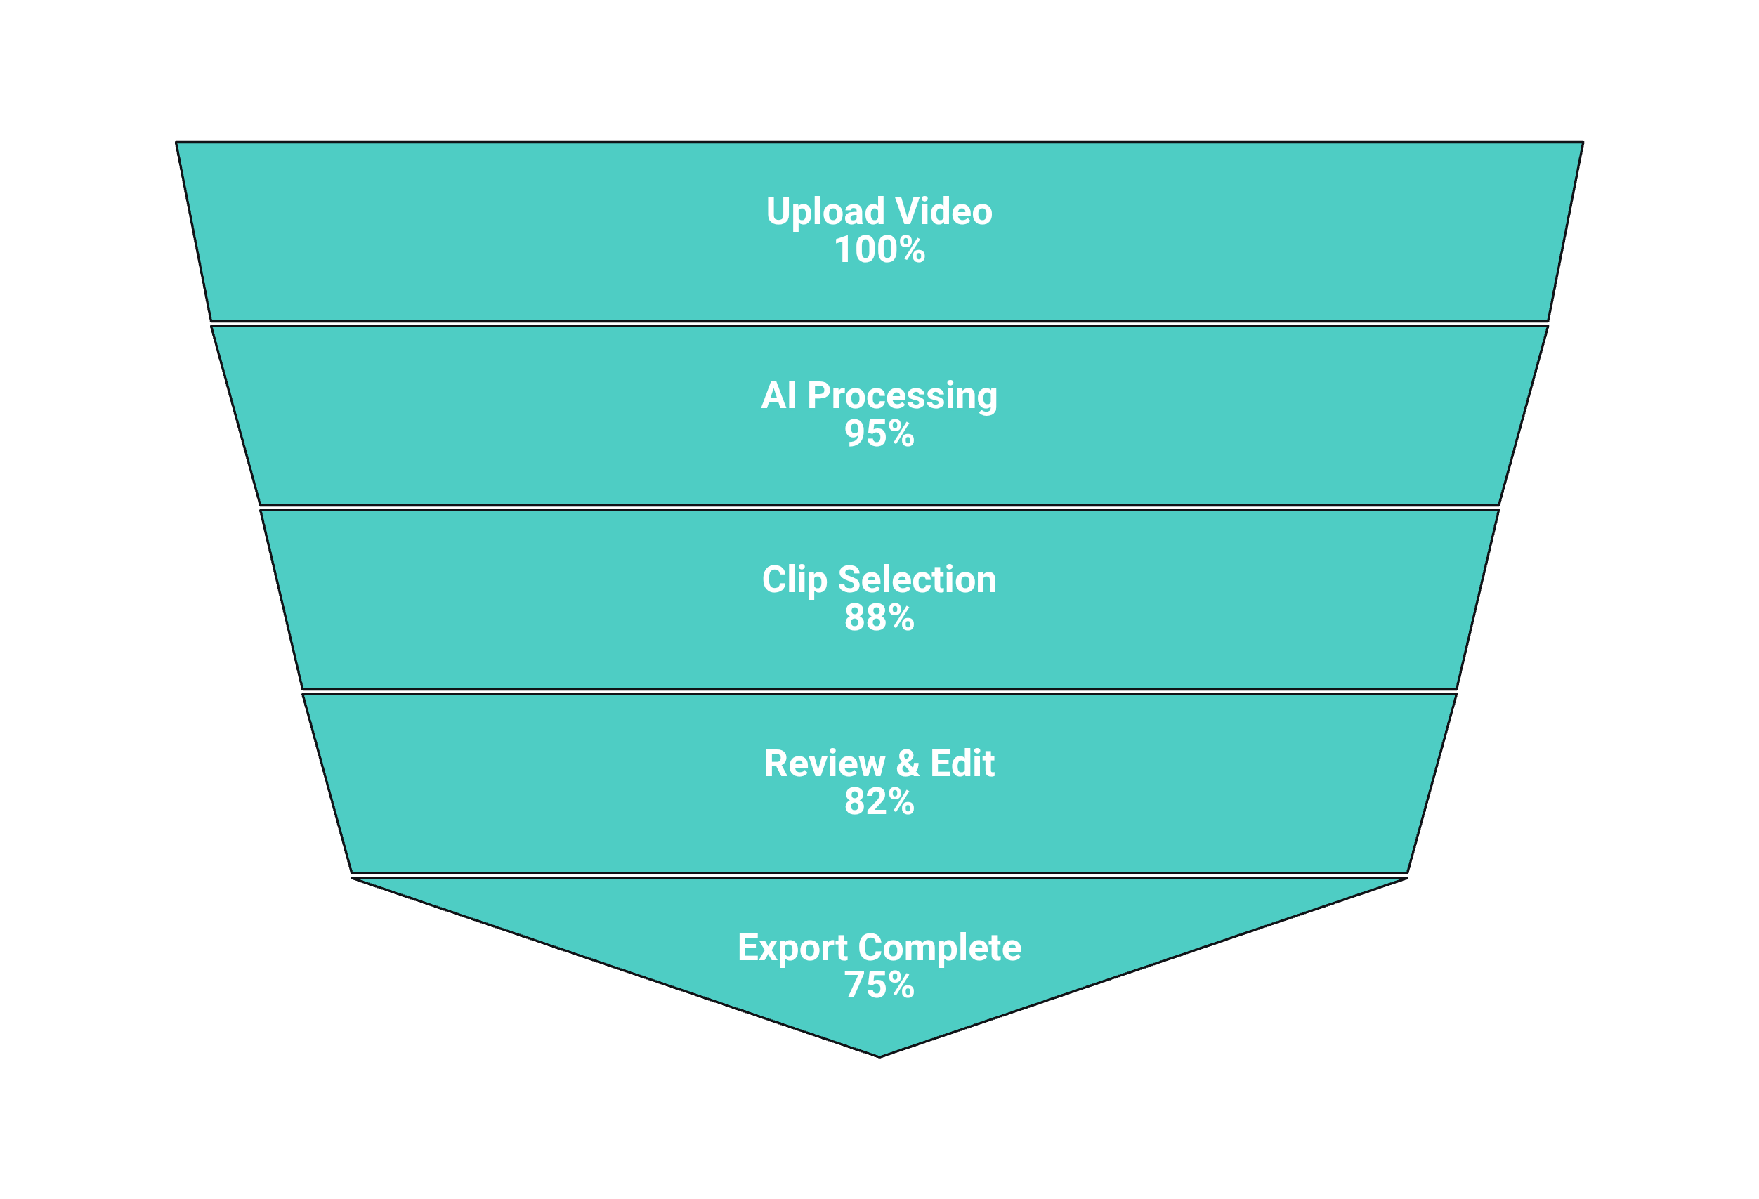
User Experience
From Upload to Viral
Complete User Flow
1
Upload Video
Drag-and-drop interface supporting files up to 1GB. Accepts MP4, MOV, AVI formats.
2
AI Analysis
Real-time multimodal processing with progress indicators for audio, visual, and text analysis.
3
Review & Edit
Intuitive interface for reviewing clips, previewing vertical crop, and editing captions.
4
Export & Share
One-click export to TikTok, Reels, and Shorts with optimized formats and generated hooks.

Slide 11
Competitive Advantage
Why We're Different
Current tools focus on basic clipping and silence detection. PulsePoint AI understands emotional depth, making it the only tool built specifically for educational and creator content with meaningful moments.
Feature
Pictory
Opus Clip
Adobe Express
CapCut
PulsePoint AI
True Multimodal Analysis
Emotional Intelligence
Context-Preserving Crop
Real-Time Processing
Hook Generation
Educational Focus
Legend
Processing Speed
Target Users
Full
Partial
None
13ms per second of speech
Educators, podcasters, creators

Slide 12
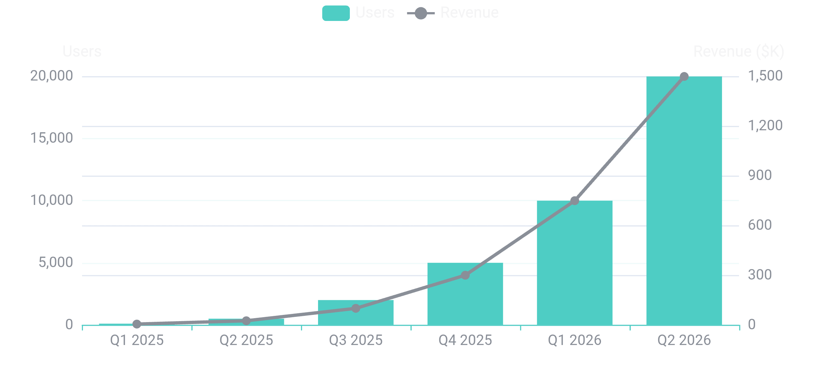
Value Proposition
Impact & Validation
15min
2.5x
10+
$100B
Time Savings
Engagement Boost
Clips per Hour
Market Size
vs. 4-6 hours manual
Short vs. long-form
Accessible content
Short-form ad spend
Beta User Feedback
Growth Projections
"Turned my 2-hour lecture into 12 engaging clips. One went viral with 50K+ views!"
- Dr. Sarah Chen
"The emotional detection is scary accurate. It found moments I didn't even realize were impactful."
- Marcus Rodriguez
"Smart crop preserved all my expressions. Other tools always cut off my forehead!"
- Jennifer Park

Slide 13
Future VisionRoadmap & Beyond <
1
MVP (Hackathon)
Long-Term Vision
Q1 2025 • 2-3 months
Core Features: Multimodal peak detection, smart cropping, caption generation
Live Streaming
Tech Stack: Python backend, React frontend, basic AI models
Real-time clip extraction during live broadcasts
Goal: Working MVP with 10 beta users
Enterprise Licensing
Universities, corporations, content agencies
2
Version 1.0
Q2-Q3 2025 • 4-6 months
AI Content Coach
Personalized suggestions for better moments
Real-Time Processing: Live analysis & batch upload
Platform Integrations: Direct posting to TikTok, Reels, Shorts
Global Expansion
Analytics Dashboard: Performance tracking & insights
Multi-language support & cultural adaptation
3
Version 2.0
Q4 2025-Q1 2026 • 6-9 months
Personalized AI Models: Trained on user's content style
A/B Testing: Automated hook/thumbnail optimization
Team Collaboration: Multi-user workspaces & approvals
Success Metrics
6 Months
1,000 users
12 Months
10,000 users
24 Months
50,000 users

Slide 14

The Future of Educational Content
Making Wisdom Viral
PulsePoint AI bridges the gap between deep knowledge and modern consumption habits.
We don't just clip videos—we extract the emotional core, the moments that move people, the insights that change minds.
Every Educator
Every Creator
Every Student
Deserves to be heard
Deserves to shine
Deserves access to wisdom
PulsePoint AI
Transforming education, one viral moment at a time

